Slide 1
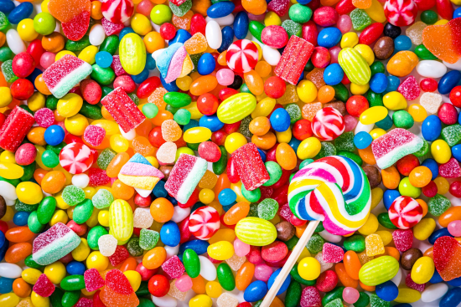
PROJECT ON ENTREPRENEURSHIP DEVELOPMENT OF CANDY MANUFACTUREING PLANT
PROJECTED BY:
RIMA DOLUI
ROLL: 2247
B.Voc (Food Processing, 6th Sem)
Department of Nutrition
Mugberia Gangadhar Mahavidyalaya
GUIDED BY :
Dr. APURBA GIRI (Assistant Professor and Head)
AYAN MONDAL(Assistant Professor)
Department of Nutrition
Mugberia Gangadhar Mahavidyalaya

Slide 3
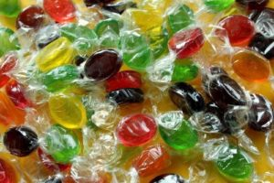
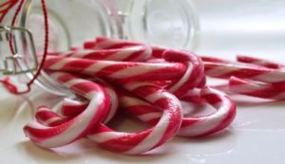
INRODUCTION
Candy is a sweet food product.
The main constituent of candy generally is sugar.
Various types of candy available in the market such as Hard candy, Candy Canes, Gummies, Lollypops, Caramels, Cotton candy etc.

Slide 4
WHY I CHOOSE CANDY PLANT ?
High demanded and attractive product.
Area of business expansion is large.
High profitable business.
Firstly I can start in small scale with low investment.

Slide 5
MARKET STUDY
Firstly, find out the most excellent and most selling candies in my location.
Check the packaging and price of those.
I need to know consumer behaviour for candy.

Slide 6
AREA AND PLANT LOCATION
Factors for ideal location :
Raw material availability.
Market location
Availability of labours
Transport facilities
Availability of water, electricity
Environmental impact and effluent disposal
Local community considerations
Political strategic consideration
Exact location: Champadanga (15000 square feet)

Slide 7
PER DAY PRODUCTION: 2050Kg( 1 candy = 3.7 g)
INVESTMENT
Objective | Cost
Land | 25,00,000
Building | 10,00,000
Equipment | 20,02,000
Total | 55,02,000
Raw material | 79,430
Manpower | 10,8,000
Transportation | 20000
Others | 50000
Total cost: Rs 5,759,430

Slide 8
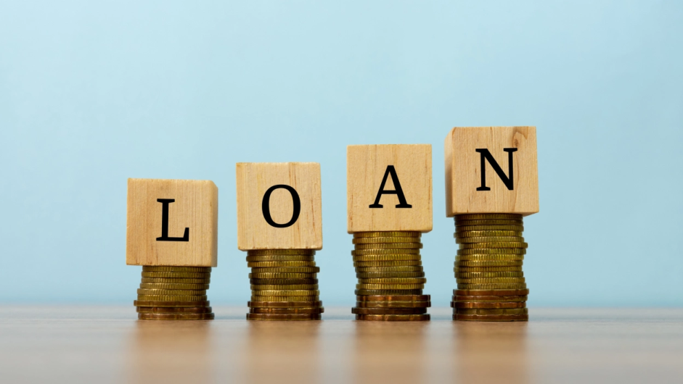
FINANCIAL RESOURCE
Bank loan
Government loan
Personal investment

Slide 9
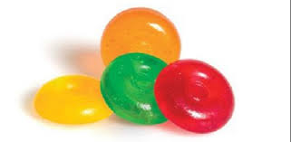
TYPES OF CANDY
Mango flavoured hard candy
Orange flavoured
Pineapple flavoured
Blue berry flavoured
Strawberry flavoured
Others

Slide 10
RAW MATERIALS
Sugar
Flavour
Colour
Glucose syrup
Citric acid
Trisodium Citrate
RAW METERIAL | AMOUNT | COST in Rs
Sugar | 1 ton | 35,000
Glucose syrup | 1 ton(36/kg) | 36,000
Water | 350 lit
Colour | 60 g( 1250/100g) | 750
flavour | 10 kg( 750/ kg) | 7,500
Citric acid | 1kg | 60
Trisodium Citrate | 1kg | 120
Total cost | 79430 ( for 2050 kg) , for 1 kg, Rs 38.74

Slide 11
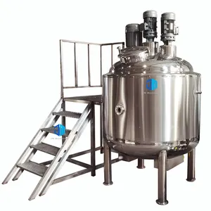
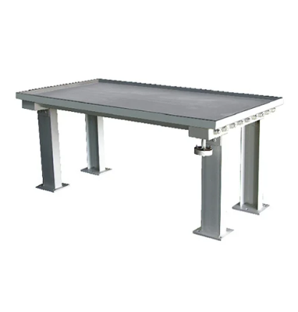
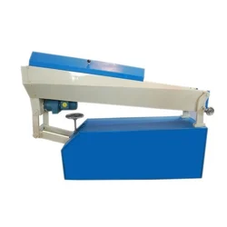
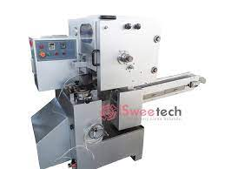
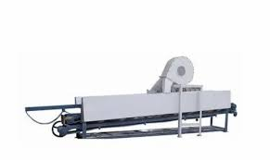
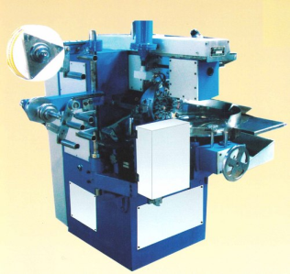
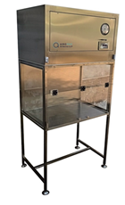
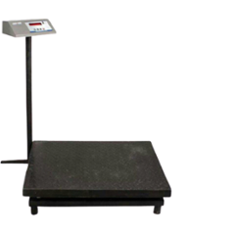
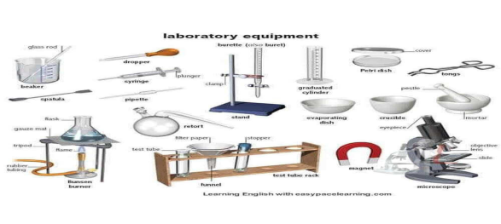
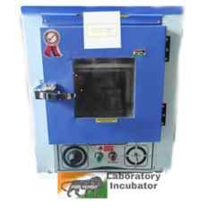
EQUIPMENTS AND MACHINARIES
Sugar dissolving tank ( 1.37 lakh)
Vacuum Cooker
(3 lakh)
Candy Cooling Plate
₹ 45,000
Batch Roller
₹ 1.45 Lakh
Five Stage Rope Seizer DRS-5
₹ 1.75 Lakh
Three way cooling conveyor
85,000
Automatic Candy Wrapping Machine ₹ 4.5 lakh
Candy forming machine
₹ 5.95 lakh
Laminar
₹ 1.75 Lakh
Incubator ₹4,236
Weighing machine
₹ 10,000
Others lab equipment

Slide 12
PROCESSING FLOW DIAGRAM OF HARD CANDY
Receiving of raw materials Weighing Lab tasting
Sugar and water
(3:1) dissolution at 100°C
Add Glucose syrup preheated at 50 to 60°C
Mixing
Dehydration under vaccum(-0.5 to -0.8 bar) up to residual moisture 2 – 3%
Cooking(138 to 145°C)
Add flavour and colour
Depositing
Packaging
Cooling at room temperature

Slide 13
LABORATORY TEST
RAW MATERIAL TEST :
Sugar: Impurity test, Brix test, Solubility test, Ash test, Moisture test
Glucose syrup: Moisture test, Brix test, Acidity test etc.
Citric acid : Purity, Moisture, Water insoluble matter etc.
Trisodium Citrate : Purity, Moisture
Colour: Water insoluble matter
Flavour: Specific gravity, Refractive index
Water : Hardness
FINAL PRODUCT TEST : Colour, texture, moisture, shape.
PACKAGING MATERIAL :
Cartoon : Weight, GSM, Moisture, Deamination
Jar : GSM
Laminate: GSM, Microbiological test
MICRO BIOLOGICAL TEST : Final product ( TPC, Yeast , etc.), Air sampling, Hand swab, machine swab, food contact surface swab etc.

Slide 14
MANPOWER
Position | Number of person | Salary/ month
Guard | 1 | 6,000
Lab | 2 | (10,000 × 2) =20000
Processing section | 2 | ( 8000 × 2)= 16000
Packaging section | 1 | 8000
Boiler | 1 | 7000
Electrician | 1 | 7000
Marketing | 1 | 8000
Overall management | 1 | 20000
Truck driver | 1 | 6000
others | 2 | (5,000 × 2) =10000
Total | 13 | 10,8,000

Slide 15
PRODUCT DETAILS
SHELF LIFE: 7 months from the date of packaging
PROFIT AND COST DISTRIBUTION
OBJECTIVE | COST ( Per 300g )
Raw material(Rs 38.74/ kg) | Rs 11.62
Packaging material ( jar /5Rs and others Rs 3) | Rs 8
Labours( 3600/ day) | Rs 0.52
Transportation cost(666.66/ day) | Rs 0.097
Electricity( 5.30/ 1 to 102 unit) | Rs 5.30
Others( Loan interest 55,000 of 60 lakh at rate 11%/ year and loan amount Rs 4583.3 /month and others) | {0.02( for loan) +0.98} = Rs 1
Total cost | Rs 26.539

Slide 16
PROFIT AND COST DISTRIBUTION
One jar content 300g ( 3.7g / candy) = 81 Candy
Amount of candy | Total cost | Distributor price | MRP | Profit
300g( 81 candy) | Rs 26.539 | Rs 70 | Each jar Rs80 and Rs1/candy | Rs 43.461
Quantity | Profit / month
1 jar | Rs 43.461
6833 jar ( 2050 kg production ) | Rs 29,683.863

Slide 17
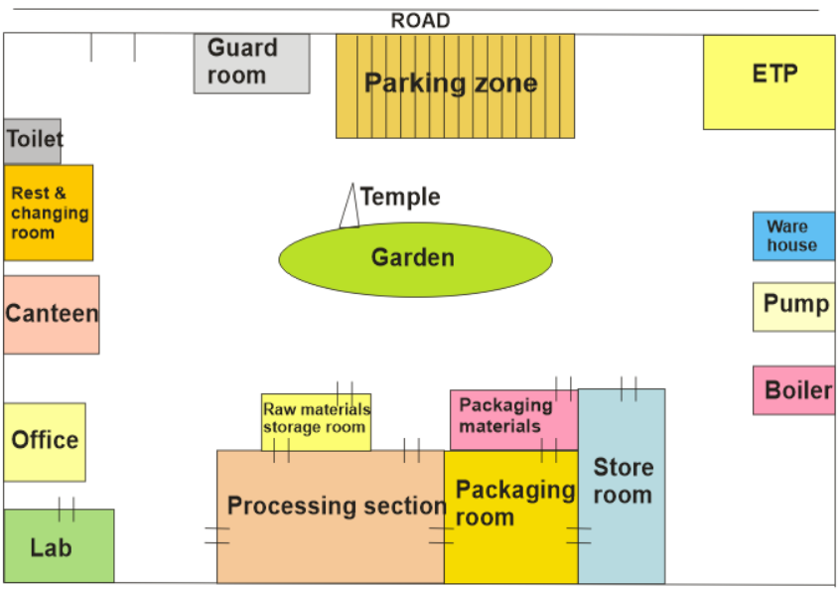
In & Out

Slide 18
CERTIFICATE AND LICENCE
Register business
GST registration
Trade License from local municipal authority
NOC from pollution board
ESI Registration
FSSAI Registration
MSME Registration
Pollution Certificate
Shop act licence
IEC code
Fire and safety
ISO 9000
ISO 14000
ISO 22000

Slide 19
TARGET SELLING AREA
Wholesalers
Distributors
Stores and shopping complex
Supermarkets
Confectionary and bakery shop
Local shops

Slide 20
SALES MODE
Offline
Online
MARKETING STRATEGIES
Advertising
Sales promotion
Direct marketing
Publicity

Slide 21
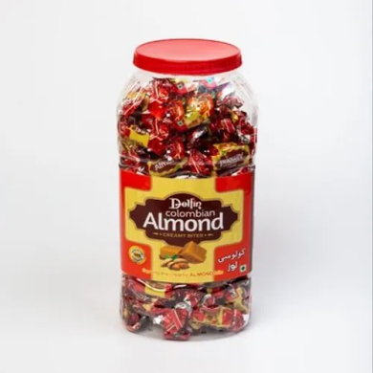
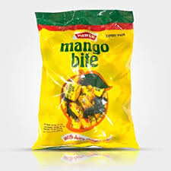
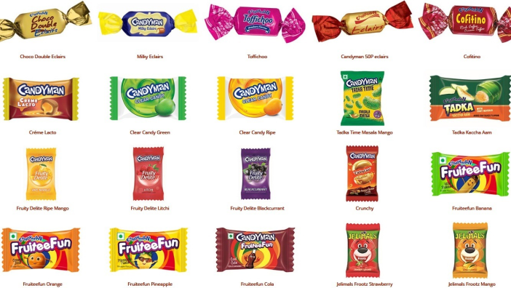
MARKET COMPITITOR AND OVER COMING STATIGES
Improve quality
Low price
Bigger seizer candy than others
Colour
Flavour
Discount
Offers

Slide 22
THANK YOU

